Slide 1
DSA Algorithm
Compare with GA and PSO
R07546015
鍾逢耘

Slide 2
Content
INTRODUCTION
MEAN and SD RESULT
Compare with PSO and GA
PROGRAM
DEMO
ITERATION RESULT
Q&A
Compare with PSO and GA

Slide 3
01
INTRODUCTION

Slide 4
01
INITIALIZATION PHASE
Dolphin Swarm Algorithm
02
SEARCH PHASE
03
CALL PHASE
04
RECEPTION PHASE
05
PREDATION PHASE
06
TERMINATION PHASE

Slide 5
02
PROGRAM

Slide 6
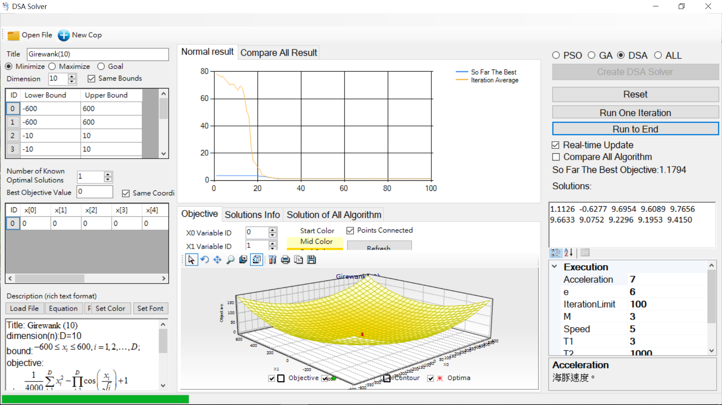
程式介面介紹

Slide 7
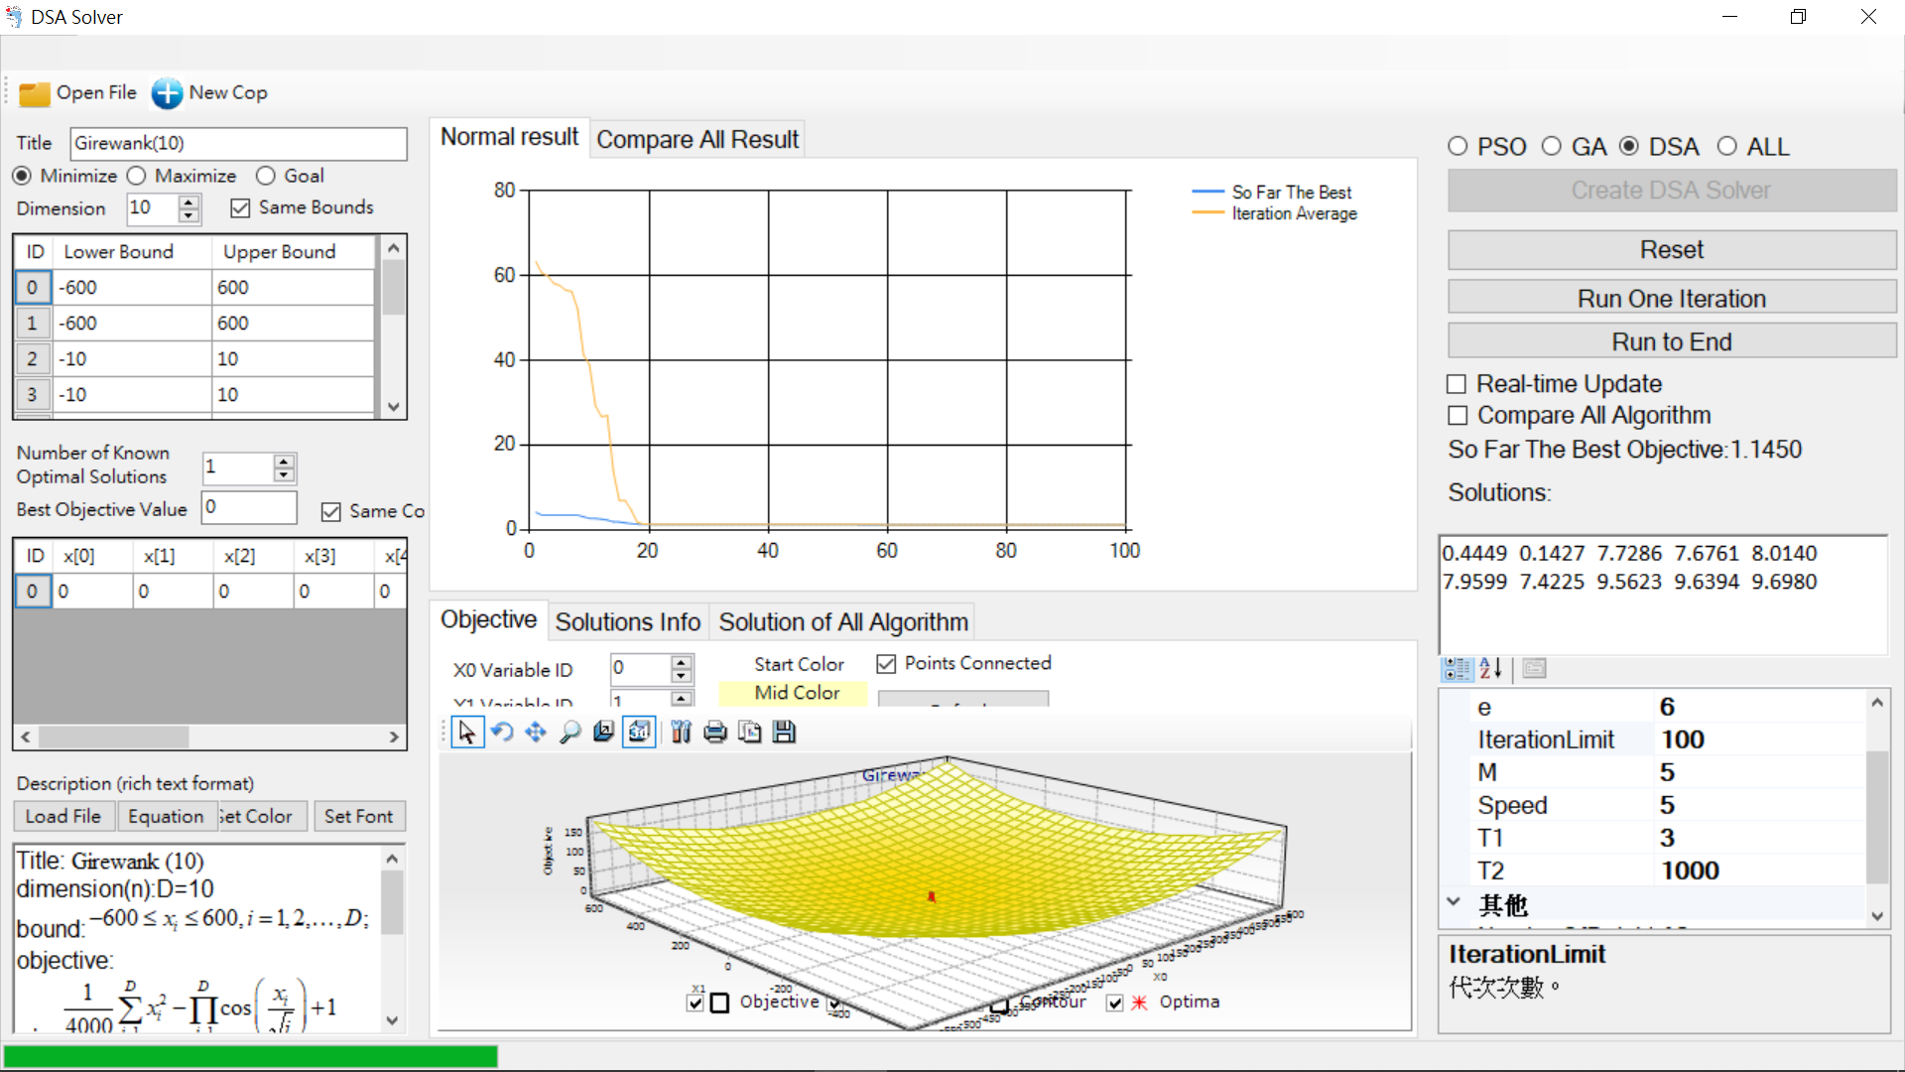

Slide 8
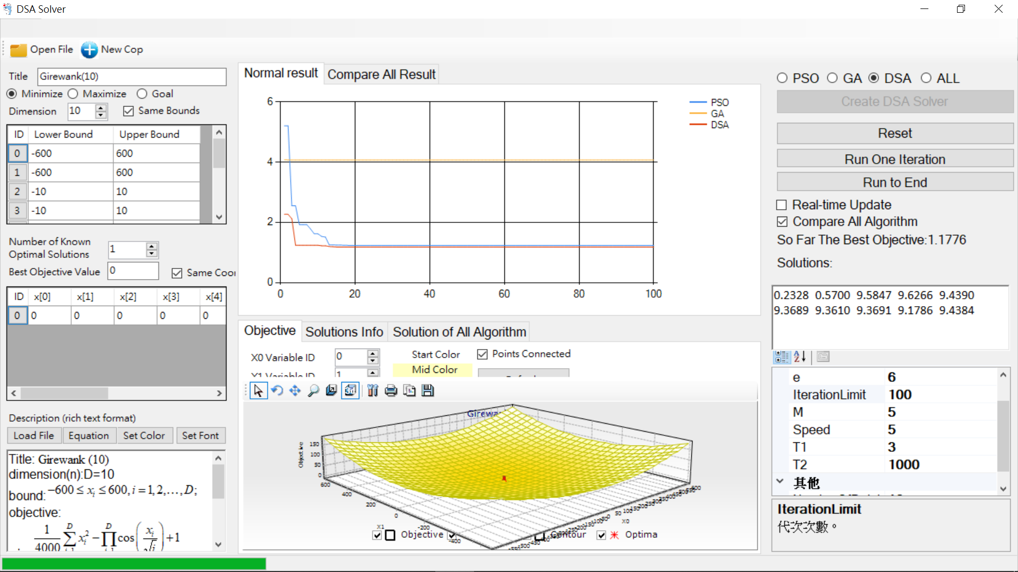

Slide 9
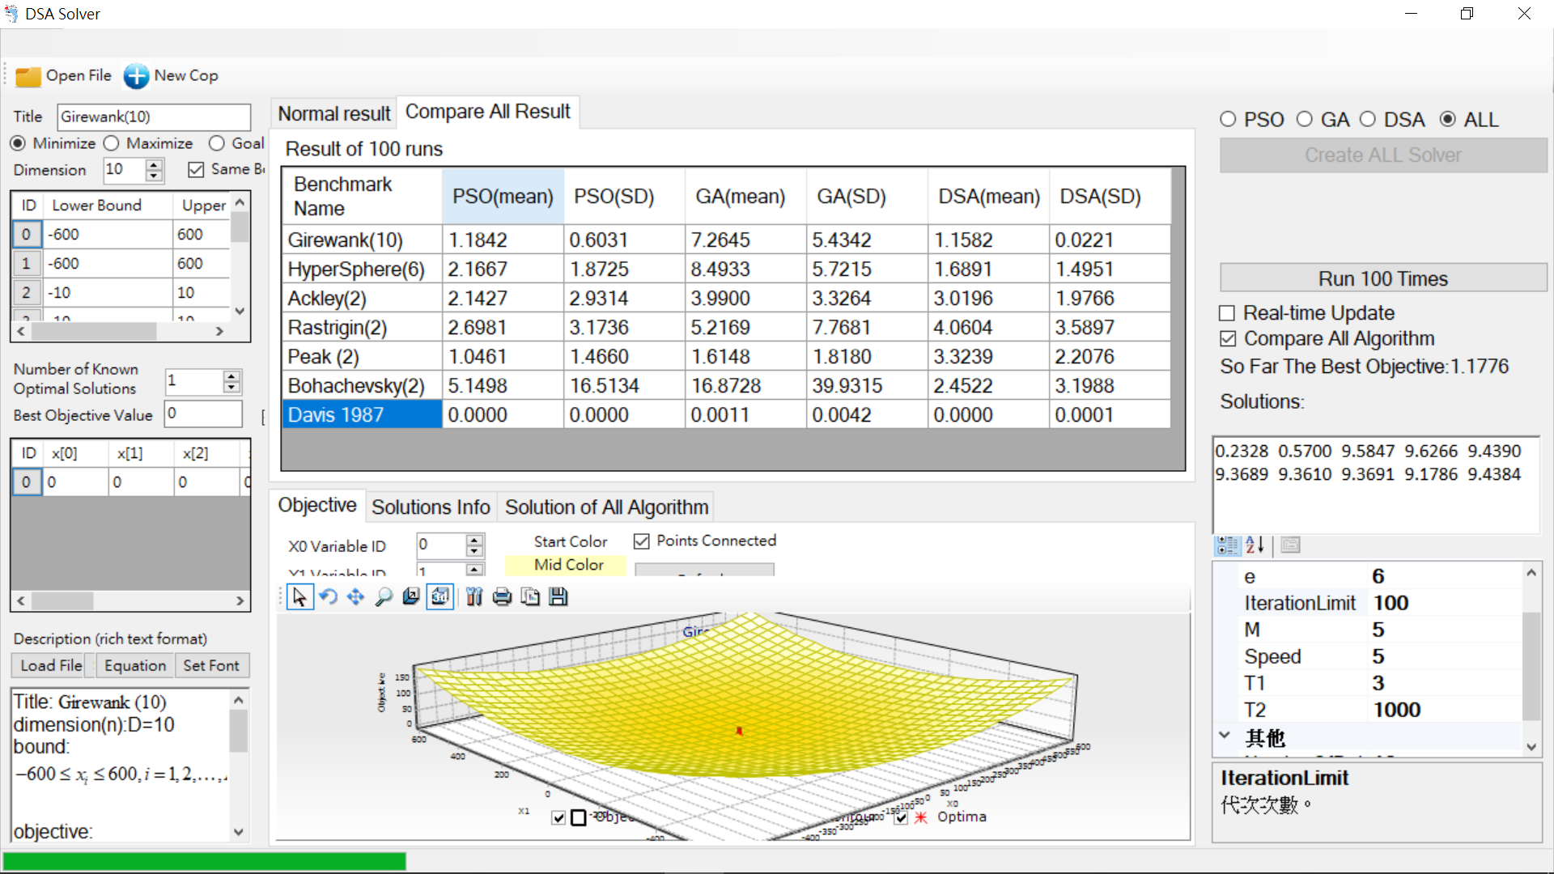

Slide 10
03
ITERATION
RESULT

Slide 11
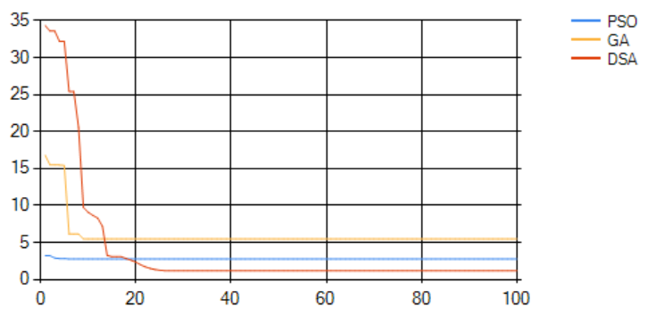
Girewank(10)

Slide 12
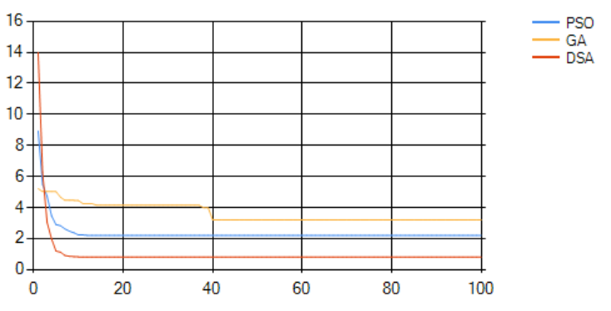
HyperSphere(6)

Slide 13
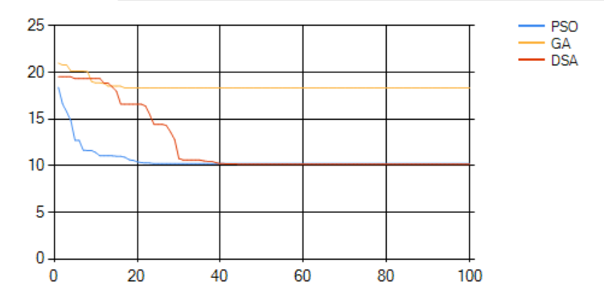
Ackley(10)

Slide 14
DSA具有信息交換導致延遲。因此，在前幾個循環中，收斂受到延遲的極大影響，但隨著海豚之間距離的減小，影響變小。
優勢在於每隻海豚有更多的時間搜索自己的周邊區域，這擴大了整個海豚群在群體層面的搜索範圍。

Slide 15
04
MEAN&SD RESULT

Slide 16
Result
Benchmark | PSO |  | GA |  | DSA
 | Mean | SD | Mean | SD | Mean | SD
Girewank(10) | 1.1776 | 0.4035 | 6.7951 | 5.9525 | 1.1596 | 0.0267
HyperSphere(6) | 2.1040 | 1.9186 | 8.7242 | 5.1297 | 1.9844 | 2.0348
Ackley(2) | 1.7708 | 2.3811 | 3.7817 | 3.8035 | 3.3638 | 2.2714
Rastrigin(2) | 3.2439 | 3.8296 | 4.6668 | 5.7583 | 3.6054 | 3.8565
Peak (2) | 1.1165 | 1.6177 | 1.4924 | 1.7210 | 2.8856 | 2.1267
Bohachevsky(2) | 6.3180 | 25.0125 | 24.2285 | 48.2924 | 3.0684 | 3.2279
Davis 1987 | 0.0000 | 0.0001 | 0.0015 | 0.0051 | 0.0000 | 0.0001

Slide 17
因為海豚在DSA附近的最佳解決方案中移動。如果鄰域最優解周圍的適應度函數的形狀過於陡峭，則捕食階段更可能移動到隨機位置。

Slide 18
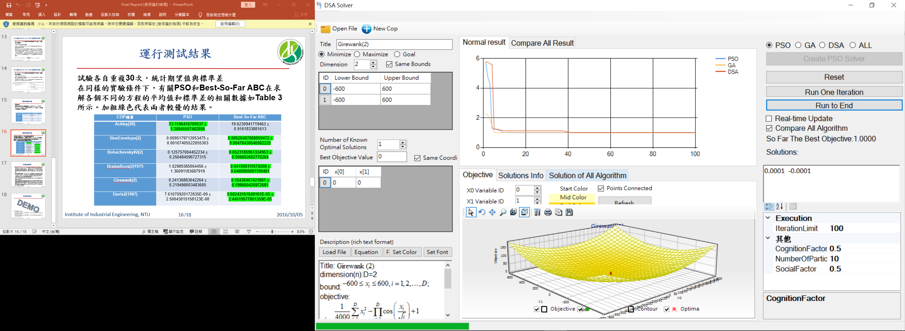
05
DEMO
https://youtu.be/HALUreIRw2A

Slide 19
06
Q&A

Slide 20
THANK YOU FOR WATCHING!
Jun Akizaki - http://thepopp.com
Used Font: Bebas Neue Family & Roboto Regular
Icon: Font Awesome, the author is Dave Gandy (Changed the color by Photoshop)

